Slide 1

Jugamos al veo veo …
Notes:
🍐 This is a Pear Deck Text Slide
🍐 To edit the type of question, go back to the "Ask Students a Question" in the Pear Deck sidebar.

Slide 2
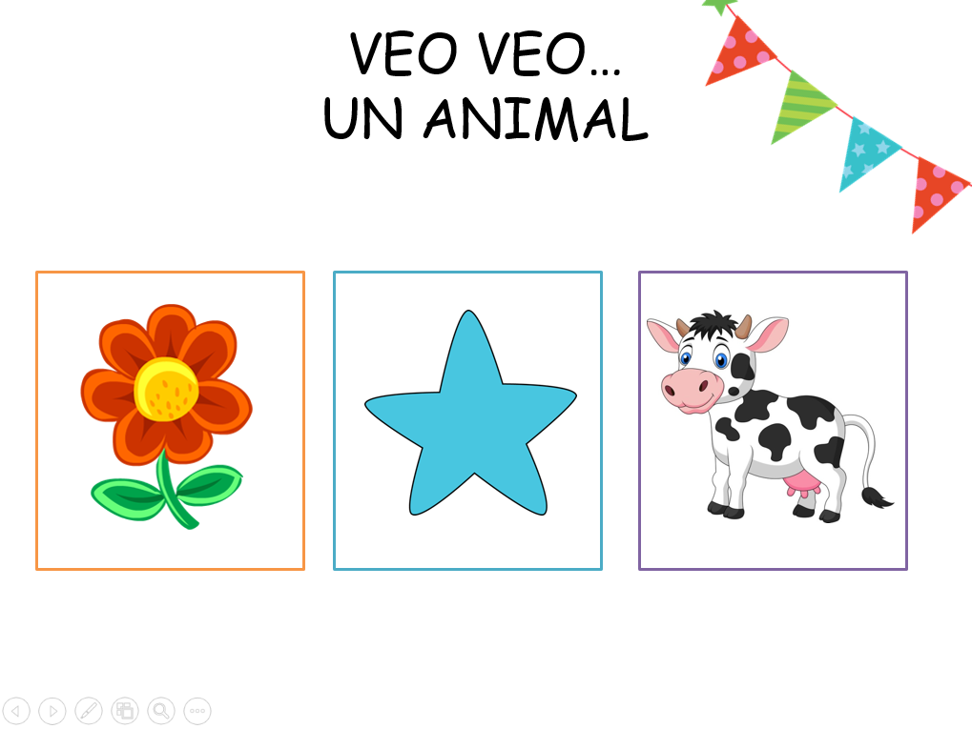


Slide 3
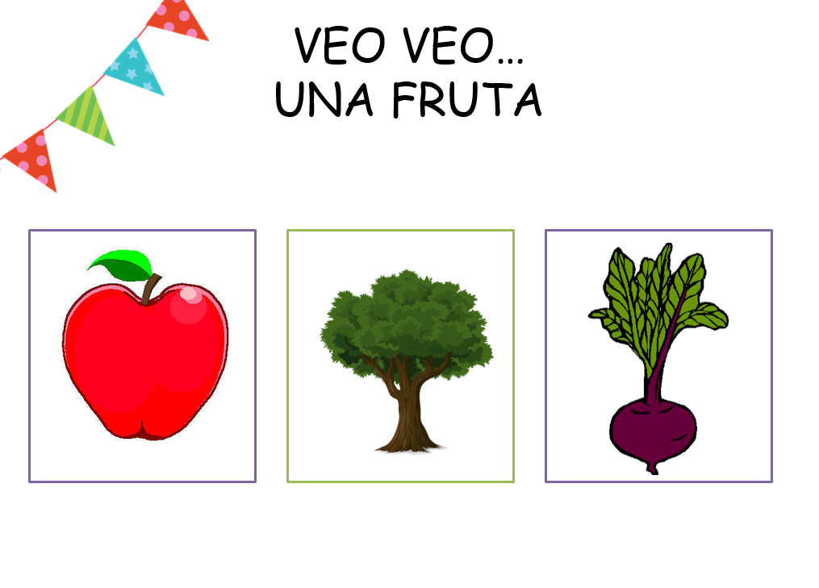

Slide 4


Slide 5
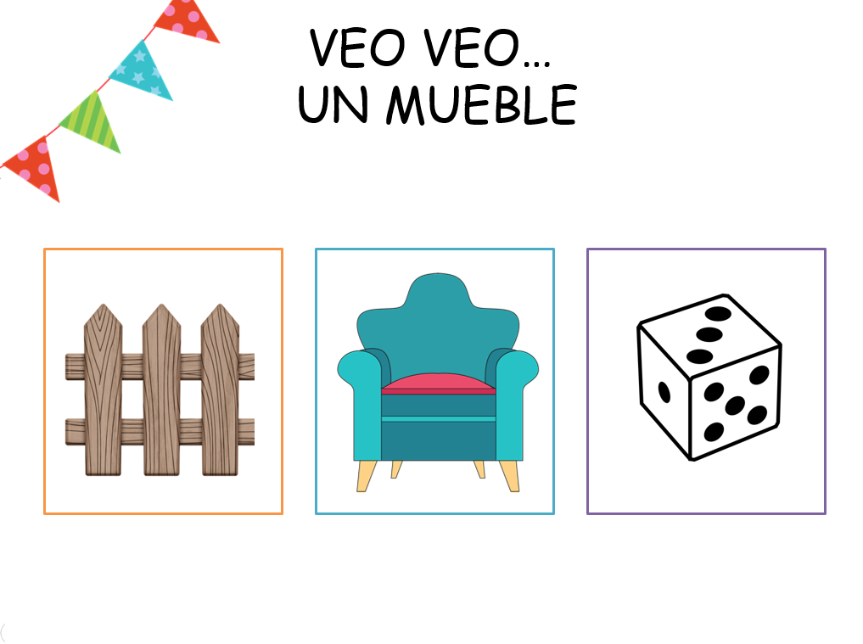

Slide 6
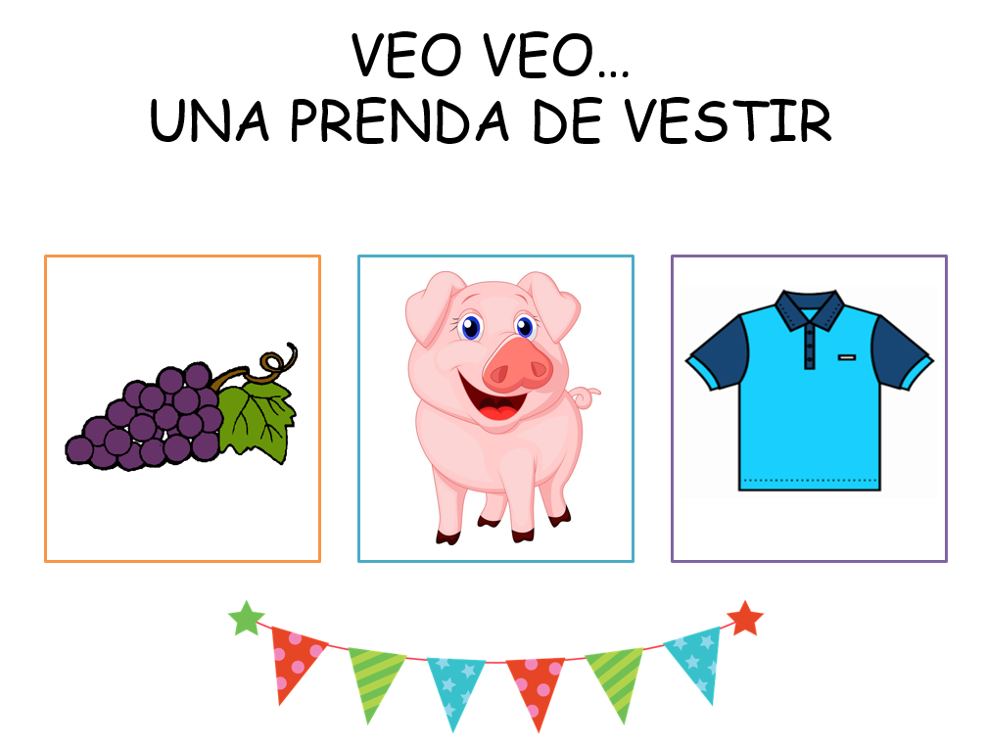

Slide 7


Slide 8


Slide 9


Slide 10
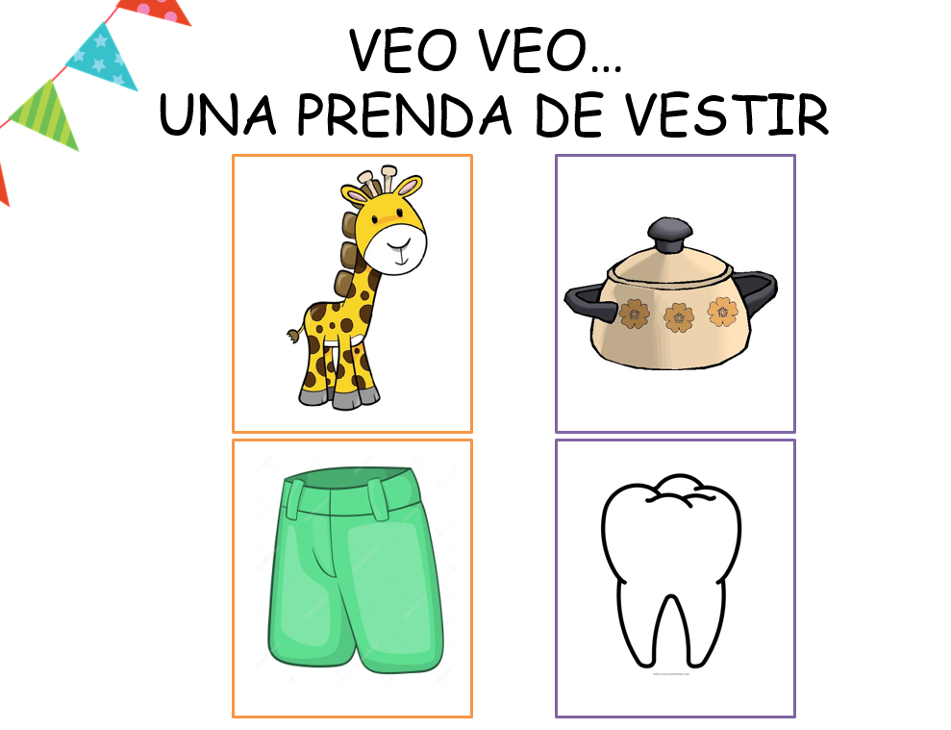

Slide 11
