Slide 1
Comprensión de oraciones
Notes:
🍐 This is a Pear Deck Text Slide
🍐 To edit the type of question, go back to the "Ask Students a Question" in the Pear Deck sidebar.

Slide 2
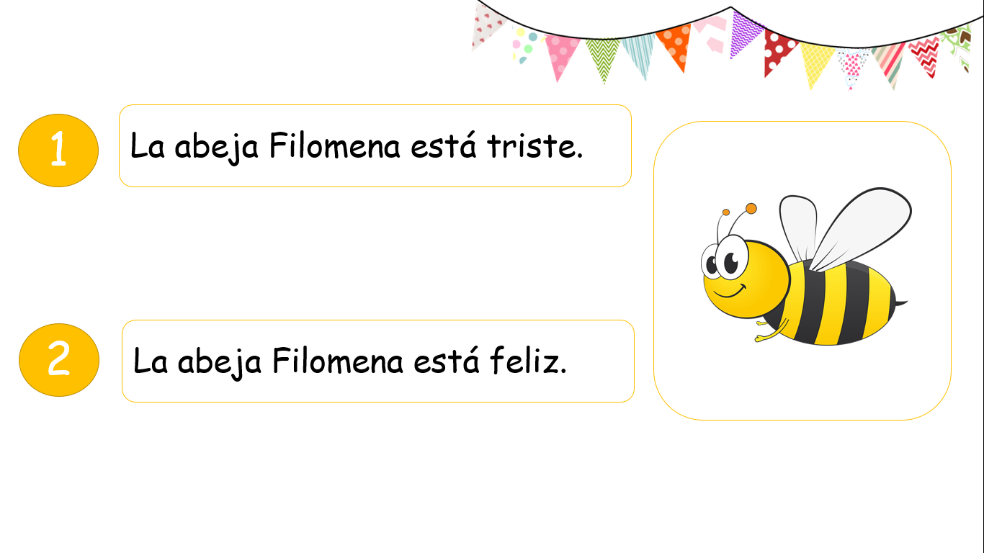



Slide 3
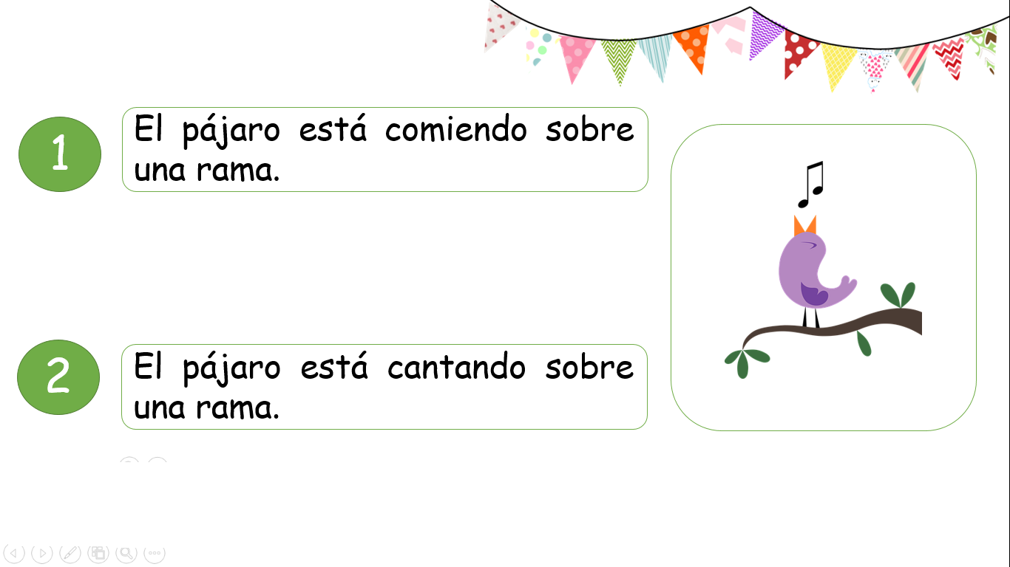

Slide 4
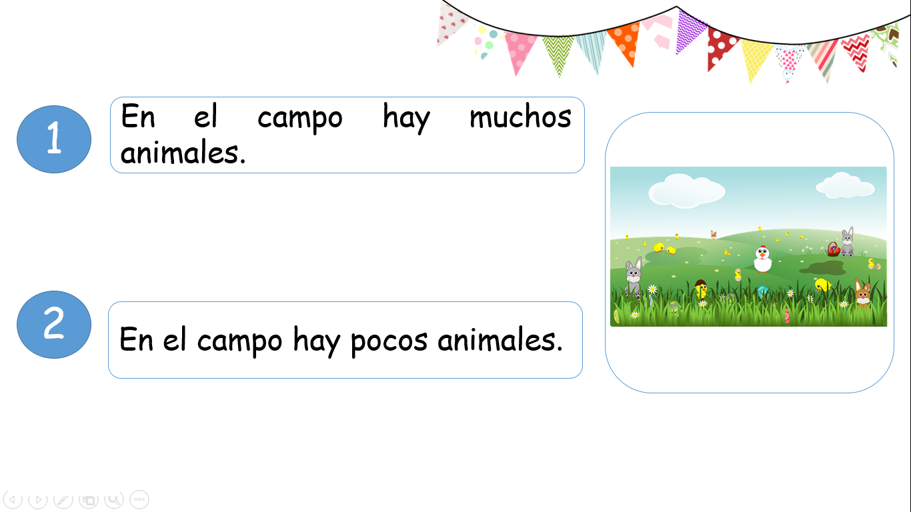

Slide 5
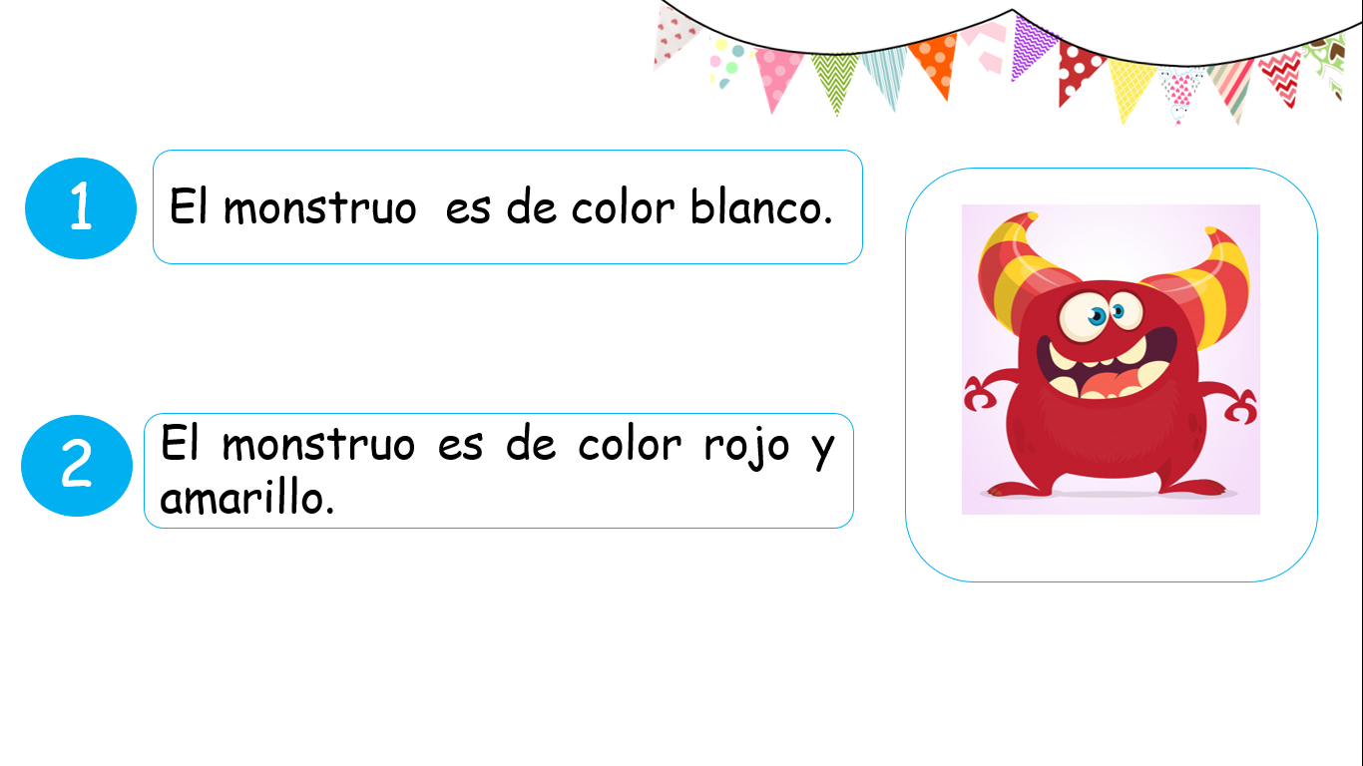

Slide 6
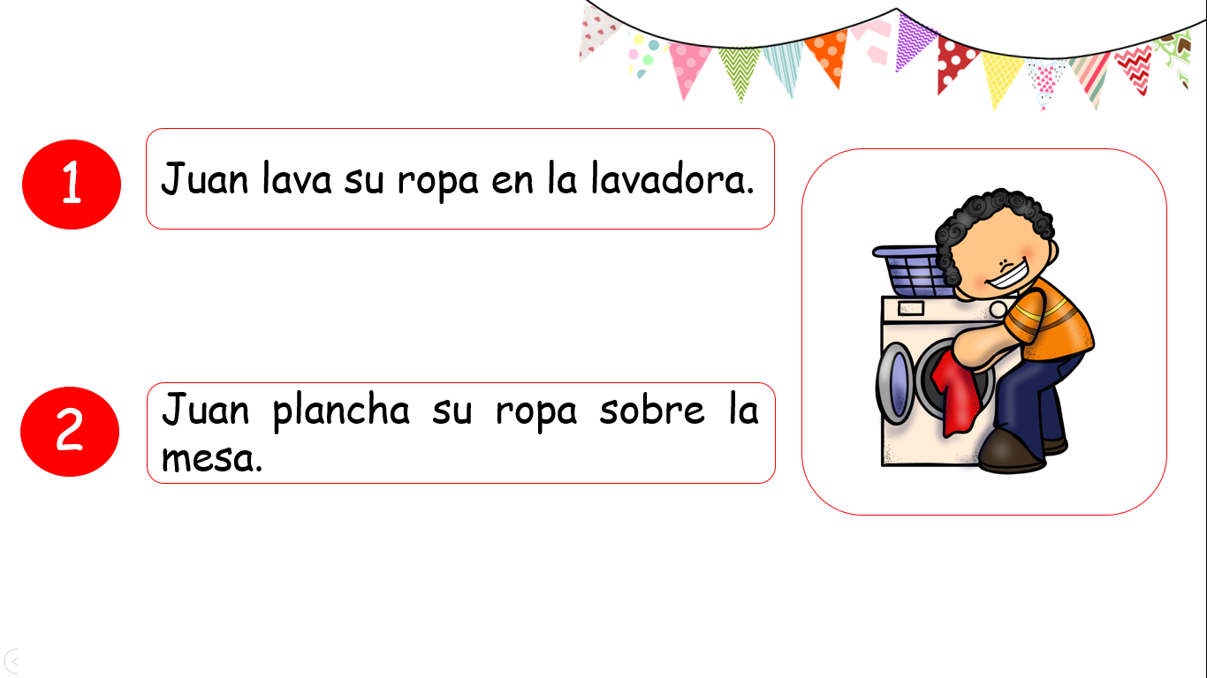

Slide 7
